Slide 1


ARTNEST- Connecting Crafters & Customers
This presentation will showcase Artnest, an innovative platform designed to bridge the gap between talented crafters and discerning customers. We address the challenges of the fragmented handmade market by offering a dedicated space for unique, high-quality goods. Join us to discover how [Your App Name] is revolutionizing the way handmade products are bought and sold.

Slide 2
The Problem: Fragmented Handmade Market
Pain Points for Crafters:
Difficulty reaching a wider audience
High marketplace fees
Lack of branding control
Complex logistics
Pain Points for Customers:
Hard to find unique, high-quality handmade goods
Limited selection on mainstream platforms
Trust issues with unknown sellers
The handmade market faces significant hurdles. Crafters struggle with limited reach and high fees, while customers find it difficult to discover unique, trustworthy items. Mainstream platforms often lack the personalized touch and curated quality that handmade enthusiasts crave. This fragmentation hinders both the growth of small businesses and customer satisfaction.

Slide 3

Our Solution: ARTNEST- A Dedicated Handmade Marketplace
A mobile app connecting crafters directly with customers
Features secure transactions, integrated shipping, and community building .
A curated platform ensuring quality and uniqueness .
Key Benefits:
For Crafters: Increased visibility, lower fees, branding opportunities, simplified shipping .
For Customers: Wider selection, unique products, support for small businesses, secure shopping experience.
we offers a seamless solution by connecting crafters and customers on a dedicated mobile platform. We provide secure transactions, integrated shipping, and a thriving community. Our curated approach ensures that customers discover exceptional, one-of-a-kind handmade goods, while crafters gain increased visibility, lower fees, and greater control over their brand.

Slide 4
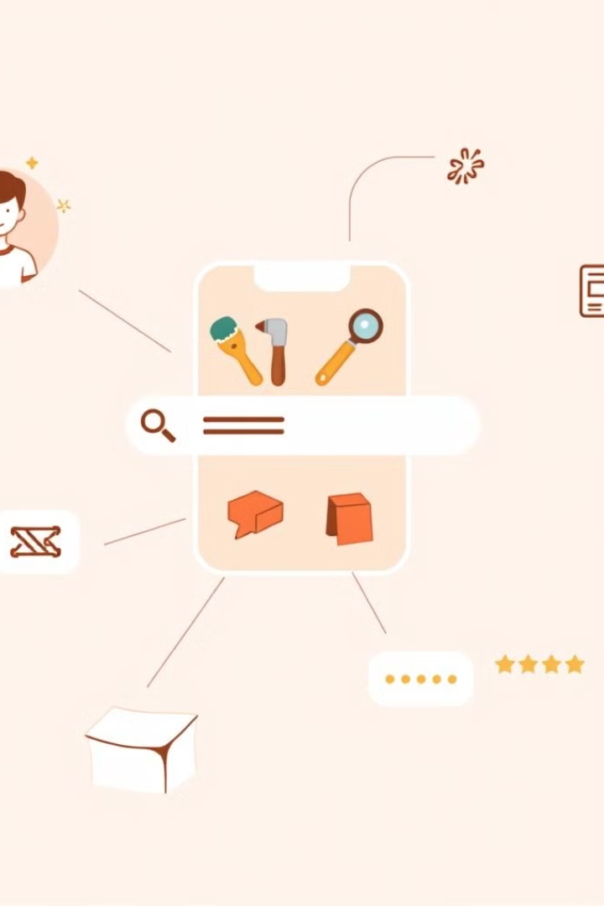
Key Features: Making Handmade Shopping Easy
Crafter Profiles: Showcase skills, stories, and product ranges
Advanced Search & Filtering: Find exactly what you're looking for
Secure Payment Gateway: Integrated with popular payment methods
Direct Messaging: Facilitate communication between crafters and customers
Reviews & Ratings: Build trust and credibility
Our app boasts a range of features designed to enhance the handmade shopping experience. From detailed crafter profiles to advanced search options, we make it easy for customers to find exactly what they're looking for. Secure payments, streamlined shipping, and direct messaging foster trust and communication between buyers and sellers, creating a vibrant marketplace.

Slide 5
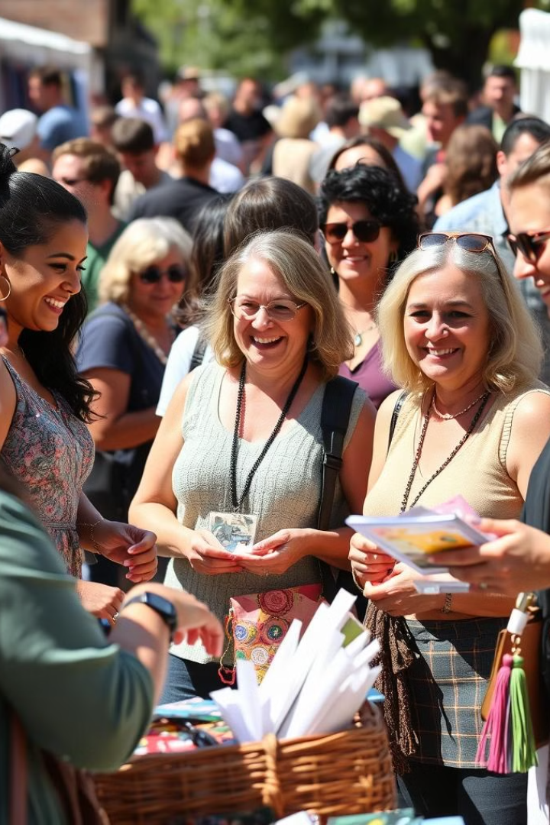
Target Market: Who Are We Serving?
Crafters:
Independent artists, designers, and artisans
Small businesses creating unique handmade goods
Individuals seeking an alternative to mainstream platforms
Customers:
Consumers looking for unique, high-quality handmade items Supporters of small businesses and independent artists
Individuals seeking personalized and sustainable products
We cater to independent artists, designers, and artisans seeking an alternative to mainstream platforms. Our customers are discerning consumers who value unique, high-quality handmade items and are passionate about supporting small businesses. They seek personalized and sustainable products that reflect their individual style and values, fostering a strong connection with the crafters behind them.

Slide 6
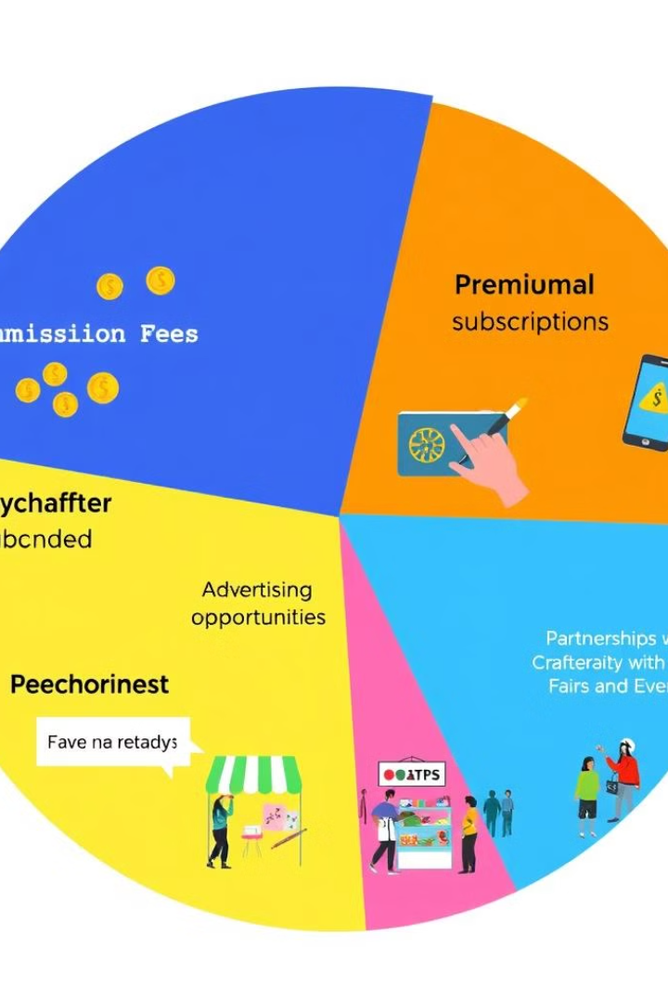

Business Model: Generating Revenue Sustainably
1.Commission Per Sale:
ARTNEST charges a % commission from every sale. Example: 10-20% per product.
2. Subscription Plans for Sellers :Monthly or Yearly membership for premium features like:• Ads for products• Better visibility• Store customization• Analytics tools
3. Delivery/Logistics Charges: Extra charge for handling or express delivery options.
Our sustainable business model is built on diverse revenue streams. We generate income through commission fees on sales, premium crafter subscriptions offering enhanced features, targeted advertising opportunities for relevant businesses, and strategic partnerships with craft fairs and events. This multi-faceted approach ensures long-term growth and profitability.

Slide 7

Marketing Strategy: Spreading the Word
Social Media Marketing: Targeted campaigns on platforms like Instagram and Pinterest
Content Marketing: Blog posts, articles, and videos showcasing handmade products and crafter stories
Influencer Marketing: Collaborations with relevant influencers and bloggers
Partnerships: Collaboration with existing craft communities and events.
Our marketing strategy focuses on reaching both crafters and customers through targeted campaigns. We leverage social media platforms like Instagram and Pinterest, create compelling content showcasing handmade products and crafter stories, collaborate with relevant influencers, and engage in public relations efforts to highlight the unique value proposition of [Your App Name].

